Slide 1

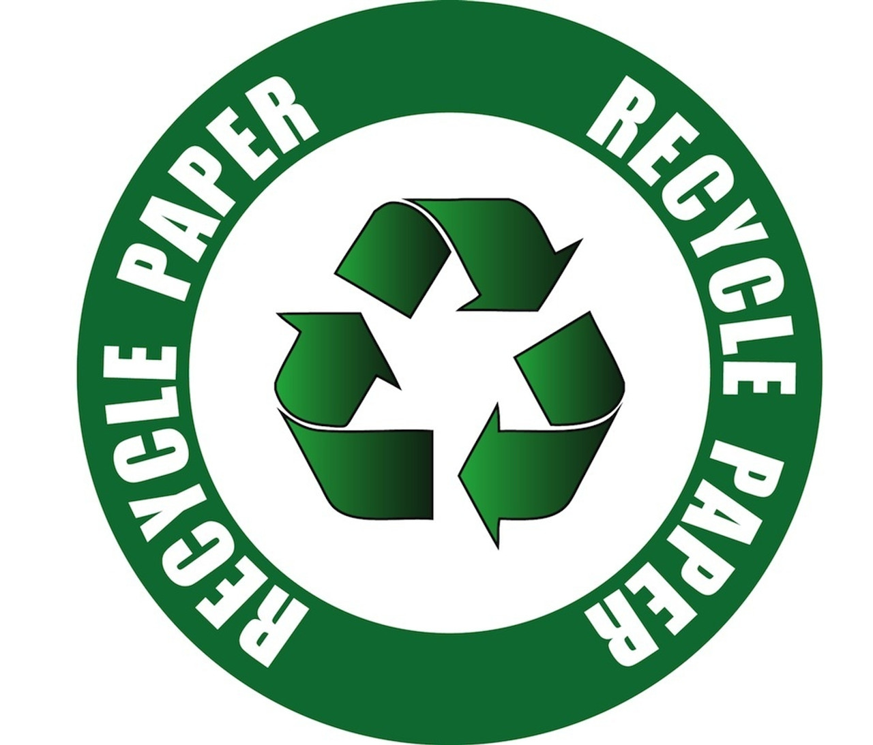
THE FUTURE
More and more consumers are looking for sustainable packaging.
The innovative paper solutions from AKAT'E are the eco-friendly
packaging alternative from AKAT'E
100% recyclable; 100% on trend. And extremely versatile to use.

Slide 2
Premium-class papers
They are smooth and coated on one side a wide range of applications in the field of flexible packaging. These include, for example, pouches, bags, sweet sachets and many others. One of their special properties is their natural whiteness, which is achieved without optical brightening. They have exceptional printing properties, excellent coating durability and excellent dimensional stability. At the same time, they provide excellent stabilization, which makes this possible printing repeatability.

Slide 3
Premium-class papers
AKAT'E printed papers are the next generation of paper for flexible packaging. They offer a sustainable alternative to the packaging industry. They are fully functional and provide product protection. They can be recycled. Moreover, they act as a barrier water vapor and aromas. We bring better and more sustainable packaging solutions to the global market for all industries.

